Slide 1
Basic Statistics
U4 – Measure
E2 – Statistics
The element ‘Statistics’ reviews the basics of statistics such as mean, deviation and probability. This element reviews a range of graphs that can be used to visualize data as well.
Yellow Belt
Notes:
Welcome to this Lean Six Sigma Academy Yellow Belt training module.

Slide 2
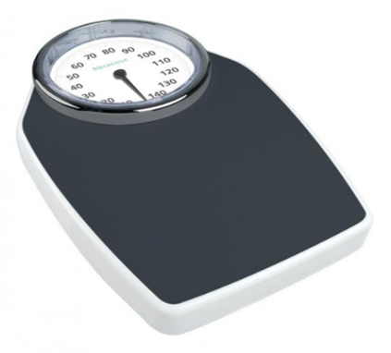
Types of Data
Scale types
Attributive data – Qualitative
  Categorical / Nominal
    Objects have no natural order (example: gender man/ woman)
  Ordinal
    Objects have a natural order, but the differences cannot
    be quantified and compared (example: seniority in a nursing team)
Variable data – Quantitative
  Interval
    Objects have a natural order and differences can be quantified and compared (example: Temperature in an operating theatre)
  Ratio
    Objects have a natural order, differences can be quantified
    and compared and there is a zero (example: one patient (140 kg) is 2 times heavier than another patient (69 kg))
Notes:
We will start by discussing four types of data: categorical, ordinal, interval and ratio data. Categorical data has no natural order within the data. For example, think of the colours of cars on the road. When there is a natural order within the data, but the differences cannot be quantified or compared, the data is ordinal. An example of this is the ‘pecking order’ within a group - we know who the boss is, but we cannot define by how much. The next type of data belongs on the interval scale. Here, there is a natural order and the differences can be quantified and compared. This could be for example the temperature of an oven: 100 °C is 80 °C hotter than room temperature. The last scale is the ratio scale, this means that besides being interval data, a meaningful zero also exists. Think of the height of an object, such as the Eiffel tower. This can be compared to an another building like the church of Utrecht with a height of zero meaning the ground level.

Slide 3
Types of Data
Attributive data – Qualitative (categorical and ordinal)
Based on categories
  Categorical variables
    Countable number of possible outcomes/ no natural order
    (example: ‘months in a year’ has 12 possible outcomes
  Ordinal variables
    Countable number of possible outcomes/ natural order
    (example : ‘I find this hospital service’: 1-very bad; 2-bad; 3-moderate; 4-good; 5-excellent)
Notes:
Next to quantitative data, there is also a type of data which we call qualitative or attributive data. The attribute or qualitative data can be categorical or ordinal. Categorical data has no natural order in the data and a fixed or countable number of possible outcomes. An example of categorical data is the name of the town or province in which we live.
The other type of attribute or qualitative data is the ordinal data type. With this type there is a natural order in the possible outcomes, but the data has no interval scale. An example is when we judge music, the 5 is better than the 4, but we don’t know how much better. This type of data is used in many questionnaires, such as those used when companies try to evaluate how satisfied we are with their service.

Slide 4
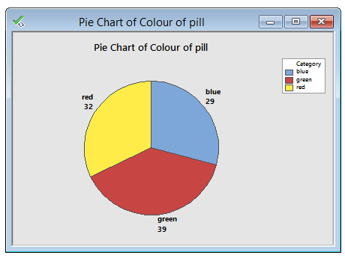
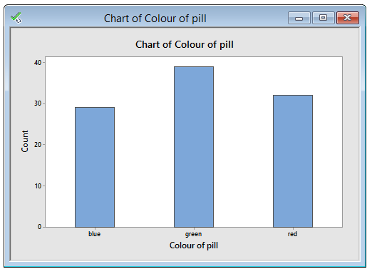
Types of Data
Example Categorical data
Nominal Data
Patients were given different pills during a clinical trial
each pill was identified by its colour
  red
  green
  blue
  red
  red
  green
  green
  green
  green
  blue
Notes:
An example of categorical data is given in the table of nominal data. Here, the colour of a pill is shown. There is no order in this type of data: green is not better or worse than red. In the pie chart, the proportion of each colour as a percentage of the total measurement is given. On the bottom, the count of each pill colour is given in a bar chart.

Slide 5
Types of Data
Variable data – Quantitative (interval and ratio)
Based on measurements and/ or counts
  Discrete - Countable
    Can be counted: a discrete (whole) number of events
    Scale is a ratio scale
    Number of patients
  Continuous - Measurable
    Can be measured on a continuous (interval or ratio) scale
    Length, time, weight
Notes:
There is also another way of looking at data. When we measure data or count objects, we talk about ‘variable data’ or ‘quantitative data’. The countable type of data is called discrete and is based on a number of events. Because there is a meaningful zero here and the differences can be quantified and compared, the quantitative data is based on a ratio scale. An example of discrete data is the number of defects in production per shift or day.
The second type of quantitative data is ‘continuous’ or ‘measurable data’. This means that the possible outcomes of the measurement lie on a continuous scale. An example of this is the length or weight of a product. The data here can be interval as well as ratio data because there is a natural order and differences can be quantified and compared.

Slide 6
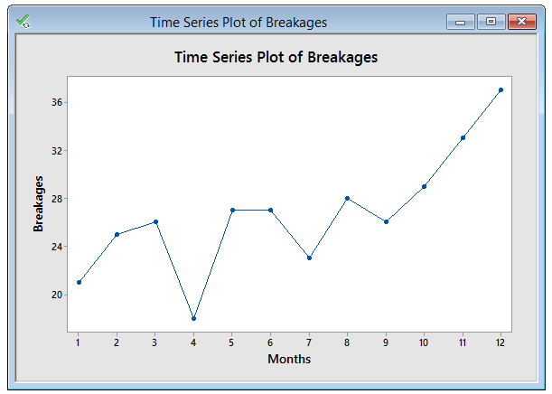
Types of Data
Example Discrete data
Number of breakages in an orthopaedic clinic
21
25
26
18
27
27
23
28
26
29
33
37
Notes:
An example of discrete data and a visualisation of this data are given here. The data is the number of breakages seen in an orthopaedic clinic. On the top right we can see an overview of one year of data in a time series plot. In this graph, the number of breakages are plotted each month..

Slide 7
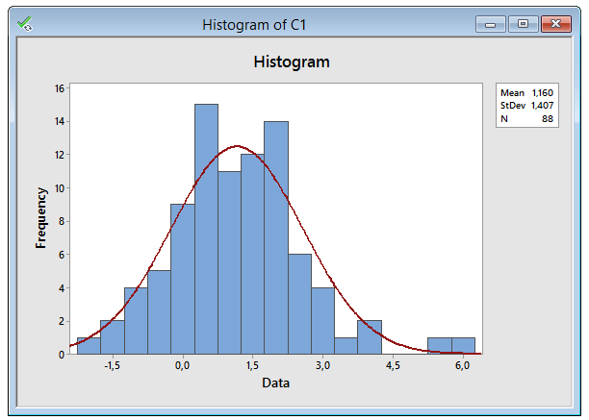
Types of Data
Example Continuous data
0.73 | 2.46 | 2.15 | 1.47
1.96 | 1.33 | 1.45 | 0.49
2.05 | -0.02 | -0.08 | 0.87
4.15 | 0.29 | 0.91 | 0.59
1.78 | -0.12 | 0.58 | 1.83
-0.08 | -0.78 | 2.22 | -0.49
1.21 | 0.10 | -2.00 | 1.80
1.48 | -1.25 | 3.09 | 1.19
0.45 | 0.95 | 1.14 | 0.72
2.91 | 2.29 | 1.14 | -1.39
2.85 | -0.34 | 1.52 | 0.80
-0.11 | 5.48 | 2.06 | 0.07
2.25 | -0.05 | 0.57 | 1.33
-0.45 | 1.47 | -1.04 | 5.91
2.69 | 2.06 | -0.18 | 1.84
1.69 | 1.32 | 0.50 | 0.60
-0.42 | 2.62 | 3.40 | 1.93
1.06 | -0.88 | 2.47 | 0.97
0.93 | 1.69 | -0.32 | 0.38
2.00 | 1.30 | 0.30 | 1.40
0.42 | 1.79 | 1.80 | 0.46
-1.49 | 0.68 | 3.16 | 4.04
Notes:
Here we can study a process which generates continuous data. In this case, we have negative as well as positive values. The frequency of each value is plotted against the data value. The histogram shows the frequency of measurements in a certain interval or bin.

Slide 8
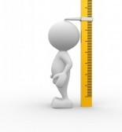
Sampling methods
Introduction into sampling
If you want to say something about a large group, you first have to do some sort of measurements
For example If we would like to say something about the length of
people, basically we should measure everybody, and average that data
Obviously that would be a lot of work…
Notes:
After discussing these different types of data, we will now address the way to obtain information from a collection of data. Sampling is a method of drawing conclusions about a process.

Slide 9

Sampling methods
Introduction into sampling
If we choose the right sample the average of the group will be pretty accurate
Population
Sample
Sample
Notes:
After discussing these different types of data, we will now address the way to obtain information from a collection of data. The total collection of a data set is called a population. To draw conclusions about these populations, we need to determine the centre (or mean) and spread (or standard deviation).

Slide 10
Sampling methods
Important definitions
Sampling
  The process of selecting a subset of items from a population
  This subset should give information about the population
Observation
  Measures one or more properties of an item selected from a population
Population
  The complete set of items whose characteristics one wishes to investigate
Notes:
There are different definitions involved in sampling methods – the sampling process, observation and population.

Slide 11
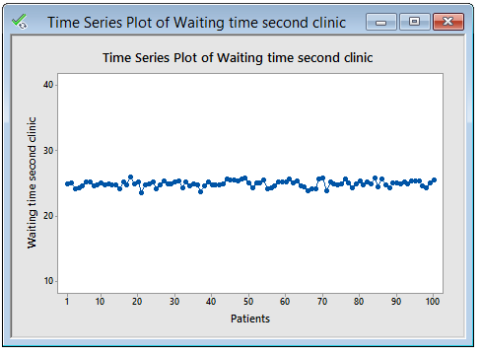
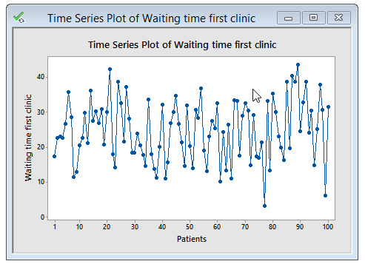
Variation
Variation is everywhere
Process A – the waiting time for one hospital clinic has relatively little variation compared to:
Process B – the waiting time for another hospital clinic
A
B
Notes:
Variation is natural.
Controlled variation is what we are after. Predictable. controlled variation can be tolerated and monitored / compensated for. Random uncontrolled variation is deadly.
Process B is not in control: several data points are outside the control limits. These points are called ‘outliers’ or special causes. Our goal is to discover the cause of these outlying data points so that we can prevent them from re-occurring.

Slide 12
Variation
Is variation acceptable?
Variation is present in every process
We may accept variation when:
    The process mean is “on target” e.g. the average number of patients seen in the Emergency Unit
    The total variation is relatively small compared to the specification (expectation)
    The process is stable over time
Notes:
The main question we should ask ourselves when we study the variation in a process, is whether this variation is acceptable or not. Because variation is present in every process, we can only try to reduce variation. A basic condition of an acceptable process is a process with a mean that is “on target”. Eg the average number of patients seen in the emergency unit. We will accept the variation, if the process is stable over time and if the variation is small as compared to the specification or tolerance of the customer.

Slide 13
Process Characteristics
Understand the process to make improvements
Process variation has several components
  Centre: Is the process on target?
  Spread: How much variation is in the data?
In all cases
Use graphs and statistical parameters to visualize the process
Notes:
If we want to reduce variation, we need to understand the process. To understand the process, we must look at two parameters: the first one is the mean value or the average outcome of the process. The second one is the spread of the results around this target. If we have a wide process spread, it is more likely that points are located outside the specification limits. It is very important to use graphs and statistics to visualise the process.

Slide 14
Process Characteristics
Two measures of central tendency
  Arithmetic average: Mean
  Arithmetic mean of data
  Median Me: Median
  Middle value of sorted data
  Data: {3, 5, 4, 7, 5}
Notes:
The most commonly used statistics for central tendency are the ‘mean’ and the ‘median’. The mean or average is calculated by the sum of the data points divided by the number of points.
The median is the middle value of the data

Slide 15
Process Characteristics
Exercise: determine mean and median
  Arithmetic average: Mean
  Arithmetic mean of data
  Median Me: Median
  Middle value of sorted data
  Data : {2, 3, 4, 5, 3, 10}
Notes:
The most commonly used statistics for central tendency are the ‘mean’ and the ‘median’. The mean or average is calculated by the sum of the data points divided by the number of points.

Slide 16
Process Characteristics
Measures for spread of a sample
  Range (R)
  Absolute difference between maximum
  and minimum value from the dataset
  Variance (s²)
  Average squared distance of X
  Standard deviation (s)
  Square root of the variance s²
Notes:
There are several measures used for the spread of a sample. A selection of these are shown here. The most simple measure is ‘range’ which is the difference between the highest and the lowest value within the data set.
The most commonly used expression for variability however is ‘standard deviation’. Standard deviation shows how much variation there is from the mean or average of the data set. It is calculated by taking the square root of the variance.

Slide 17
Process Characteristics
Exercise: determine R, s² and s
  Range (R)
  Absolute difference between maximum
  and minimum value from the dataset
  Variance (s²)
  Average squared distance of X
  Standard deviation (s)
  Square root of the variance s²
  Data: {2, 3, 4, 5, 3, 7}
Notes:
Exercise

Slide 18
Normal distribution
68.26%
% of the population
95.44%
99.73%
-4 -3 -2 -1 0 1 2 3 4
Standard deviations
Normal distribution or Gauss curve
  This bell-shaped, continuous distribution is common and is characterized by the mean μ and standard deviation σ
Notes:
18
The graph shown here is a bell shaped normal distribution also called the Gauss curve (named after the German Carl Friedrich Gauss). The mean of this distribution is represented by the Greek character micron and the standard deviation is represented by the sigma.

